Slide 1
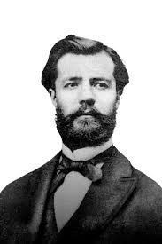
HENRI FAYOL’S
PRINCIPLES
OF
MANAGEMENT

Slide 2
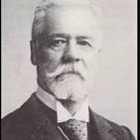
HENRI FAYOL
Henri Fayol was a French mining engineer who became a key figure in developing management theory. He's often called the "Father of Modern Management"

Slide 3

PRINCIPLES OF MANAGEMENT
Principles of management are universally applicable rules or recommendations that guide the behavior or decision-making of a manager.

Slide 4

IMPORTANCE OF MODERN MANAGEMENT THEORY
Fayol ’s 14 principle of management -one of the earliest theories of management to be created. -it incorporated proven principles , elements , procedure and techniques based on his practical experience.

Slide 5


14 PRINCIPLES OF MANAGEMENT
DIVISION OF WORK
AUTHORITY AND RESPONSIBILITY

Slide 6


DISCIPLINE
UNITY OF COMMAND

Slide 7


UNITY OF DIRECTION
SUBORDINATION OF INDIVIDUAL INTEREST TO GENERAL INTEREST

Slide 8


REMUNERATION
CENTRALIZATION AND DECENTRALIZATION

Slide 9
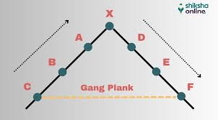

SCALER CHAIN
ORDER

Slide 10


EQUITY
SATBILITY OF TENURE OF PERSONNEL

Slide 11


INITIATIVE
ESPRIT DE CORPS

Slide 12

CREATED BY :-TANISHA VARSHNEY
BATCH ID:-241004514302

